Slide 1
Finding the equation of the line
ay + bx + c = 0
Graphical representations of linear equations

Slide 2
how to use Oak lessons

Slide 3
I can appreciate that writing linear equations in the form ay + bx + c = 0 may be more appropriate.

Slide 4
An equation of a line is any equation whose graph forms a straight line.

Slide 5

Finding the equation of the line ay + bx + c = 0
Equations in the form y = mx + c
Equations in the form ay + bx + c = 0

Slide 6
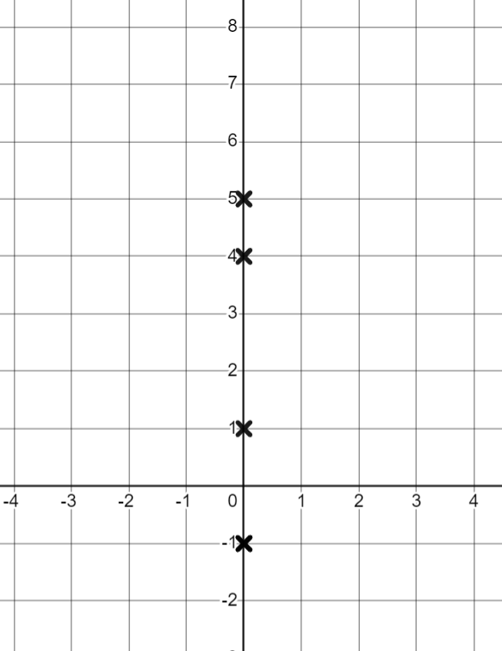
Equations in the form y = mx + c
The format y = mx + c for an equation of a straight line is useful to identify the gradient and y-intercept.
The coefficient of x is the gradient as this tells us how much y will increase for each increase of 1 in the x direction.
The constant represents the y-intercept as this is the value of y when x is zero.
x = 0 (y-axis)

Slide 7
Equations in the form y = mx + c
What will the y-intercept be for the equation y = 2x + 5 ?
(0, 5)
We know the y-intercept occurs when the x coordinate is 0
Substituting x = 0 into the equation of the line
y = 2 (0) + 5
y = 0 + 5
y = 5
Multiplying any value by 0 gives an answer of 0
If x = 0, the value of the x term must be 0, for any coefficient.
Which makes y equal to the constant. Hence the constant is the y-intercept.

Slide 8
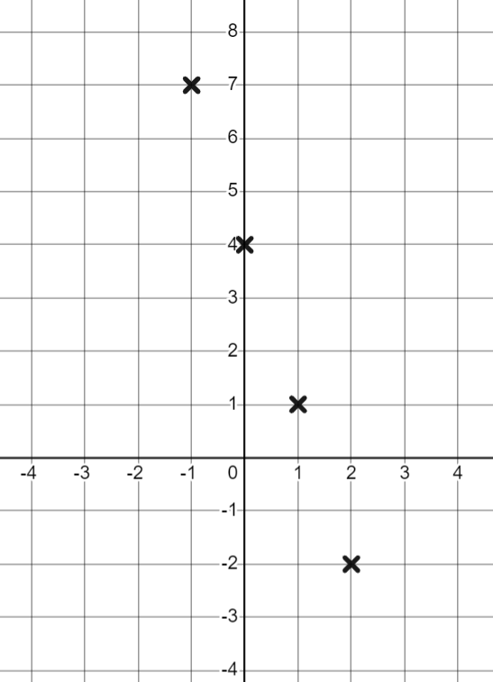
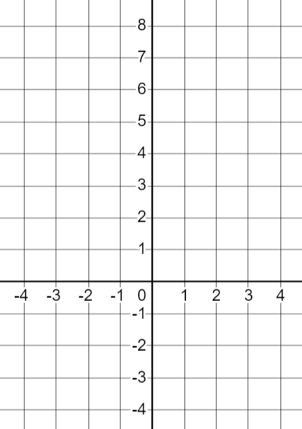
Equations in the form y = mx + c
Knowing these key features can help us draw graphs from their equations.
How could we draw the graph of y = 4 − 3x ?
We could use a table of values.
x | −2 | −1 | 0 | 1 | 2
y
10
7
4
1
−2
Then plot these coordinates.
Then draw a line through them.

Slide 9
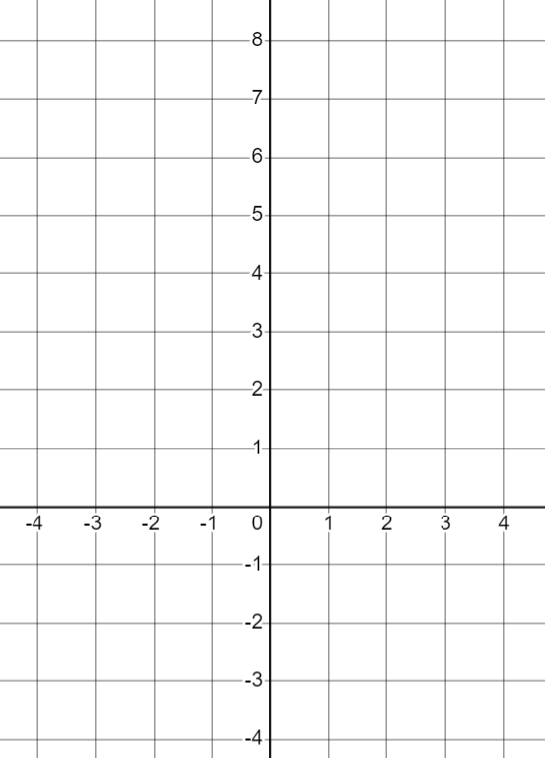
Equations in the form y = mx + c
Or we could use the key features of the graph:
y = 4 − 3x
We know the y-intercept is (0,4) so we can plot it.
We know the gradient is −3
×
For every 1 increase in x, y decreases by 3
×
We can now plot the coordinate when x = 1
We can continue the pattern and plot the coordinate when x = 2
×
Then we can draw the rest of the line with gradient −3

Slide 10
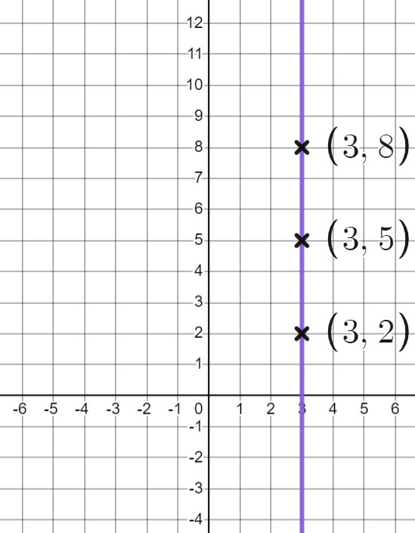
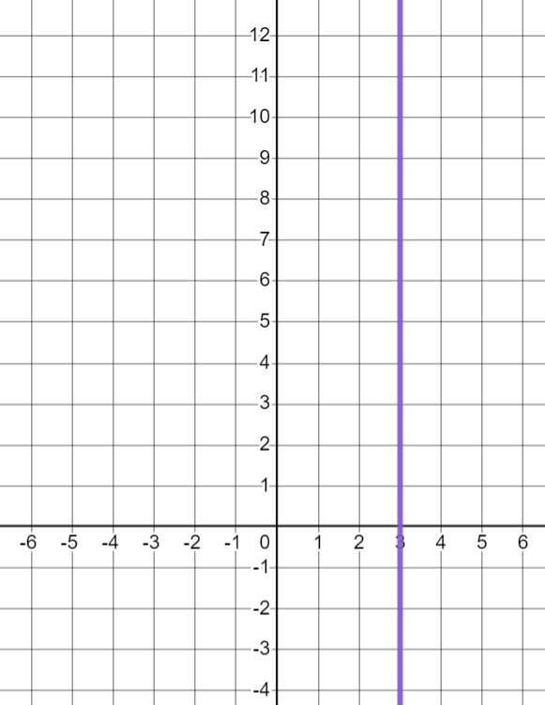
Equations in the form y = mx + c
Can you think of any equations of lines which cannot be written in the form y = mx + c?
Can you think of any lines which will not have a y-intercept?
Vertical lines!
What coordinates lie on this line?
What could we call this line?
x = 3

Slide 11
Equations in the form y = mx + c
Equations for vertical lines can be written in the form x = a where (a, 0) is the x-intercept.
They cannot be written in the form y = mx + c
They do not have a y-intercept.
Their gradient is infinite and cannot be written as a numerical value.

Slide 12

Equations in the form y = mx + c
All straight lines can be written in the form y = mx + c
Once you have found the gradient and y-intercept you can write the equation in the form y = mx + c
Vertical lines cannot be written in the form y = mx + c as they do not have a y-intercept and the gradient is infinite.

Slide 13
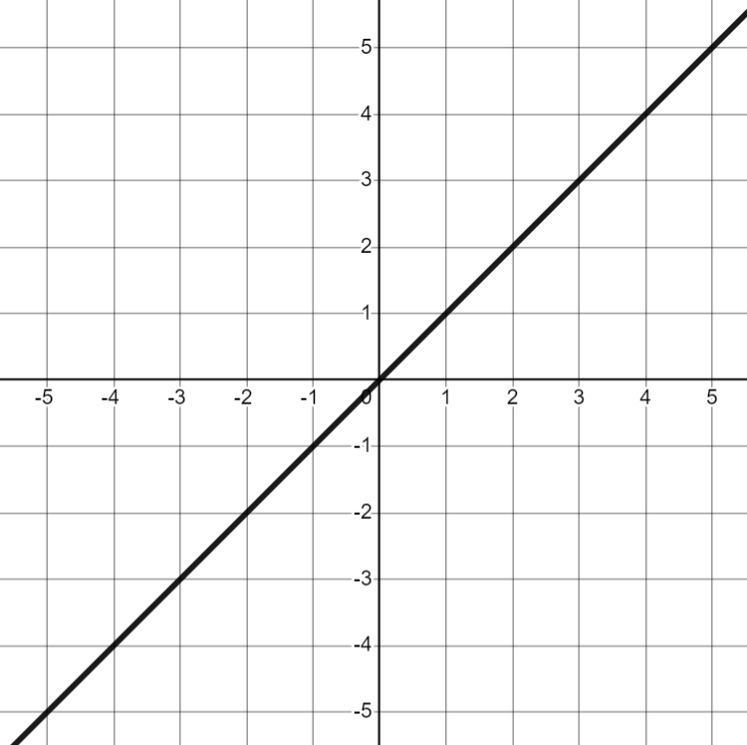
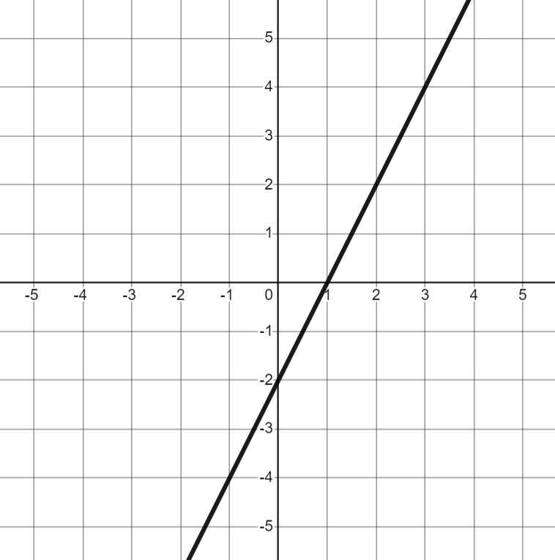
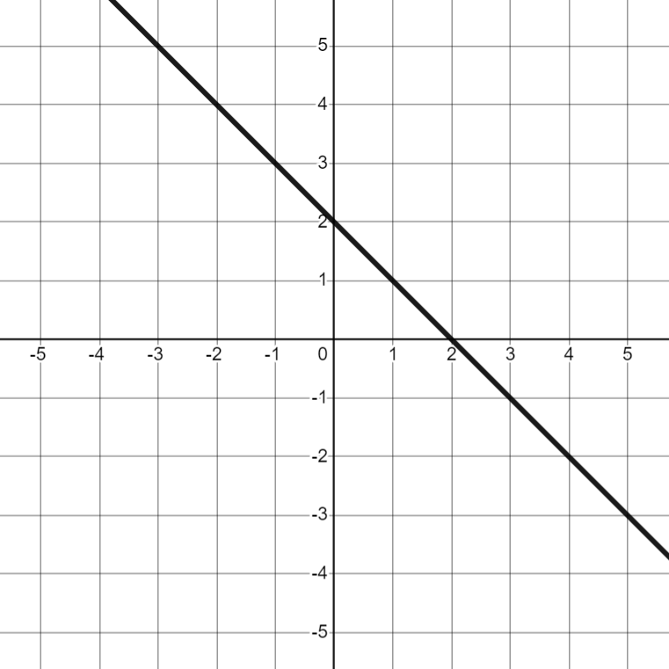
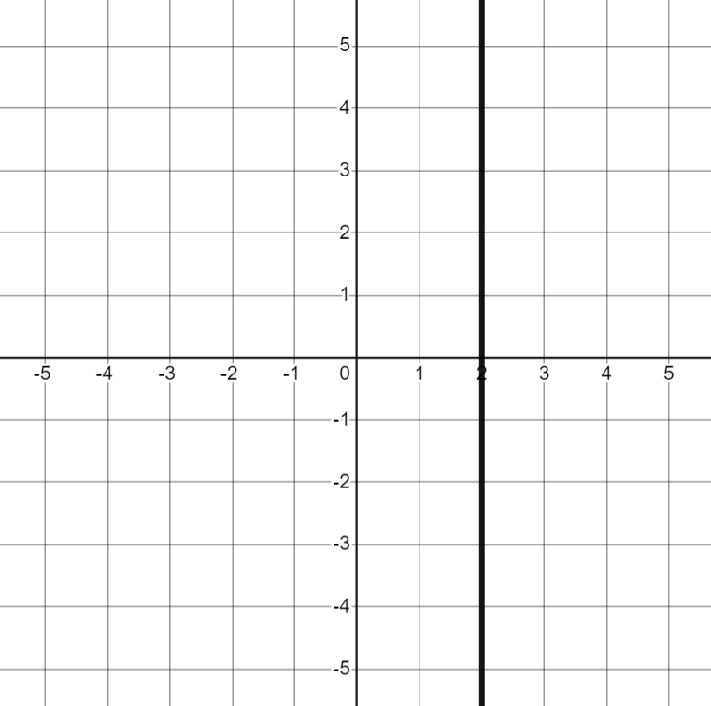
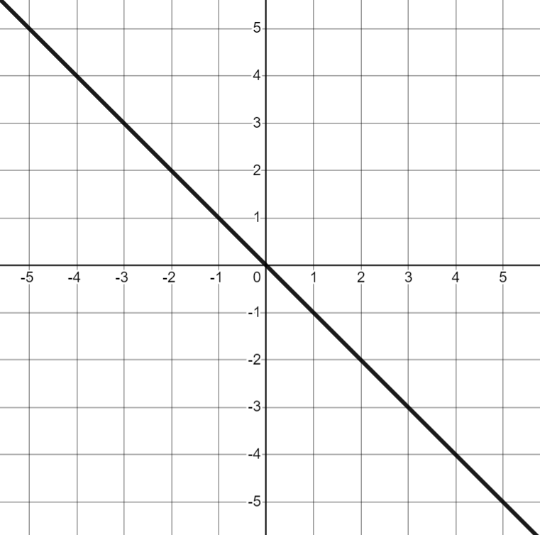
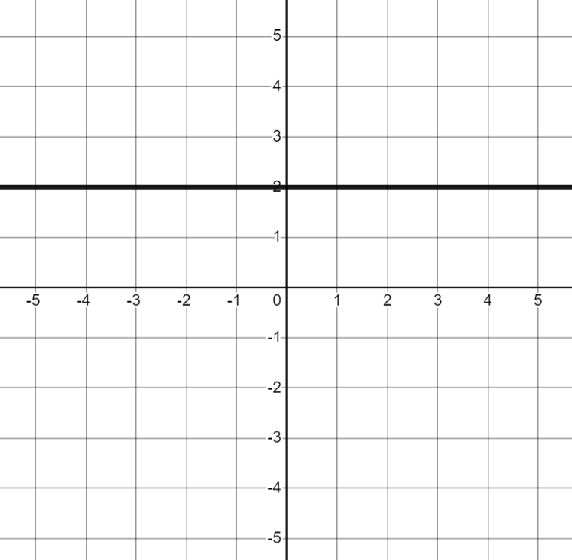
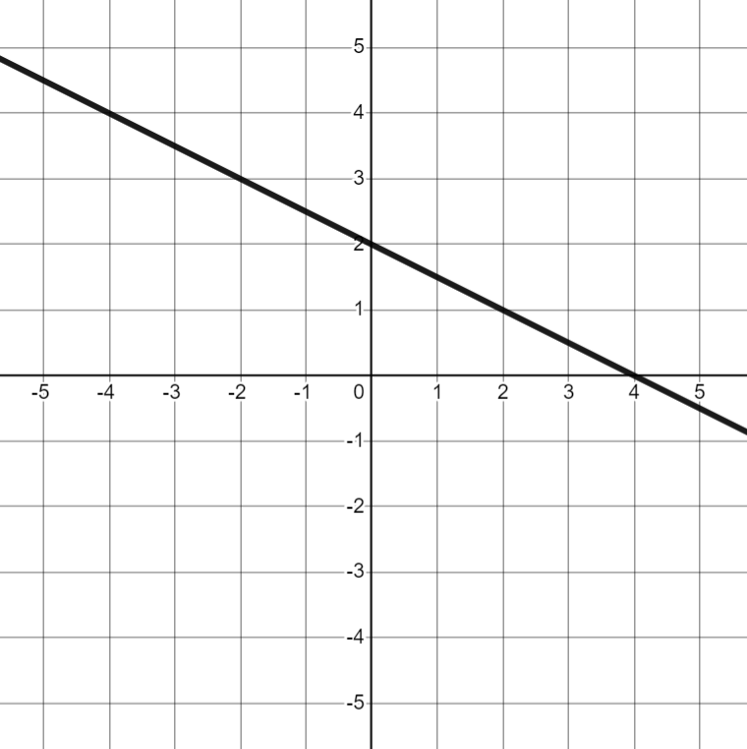
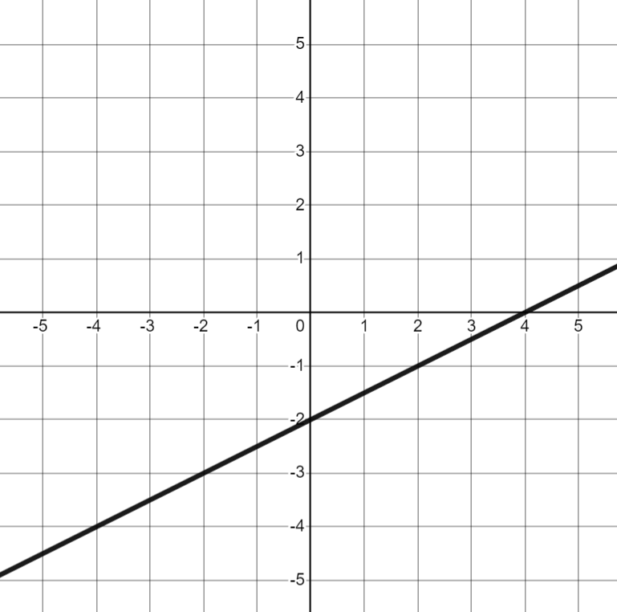
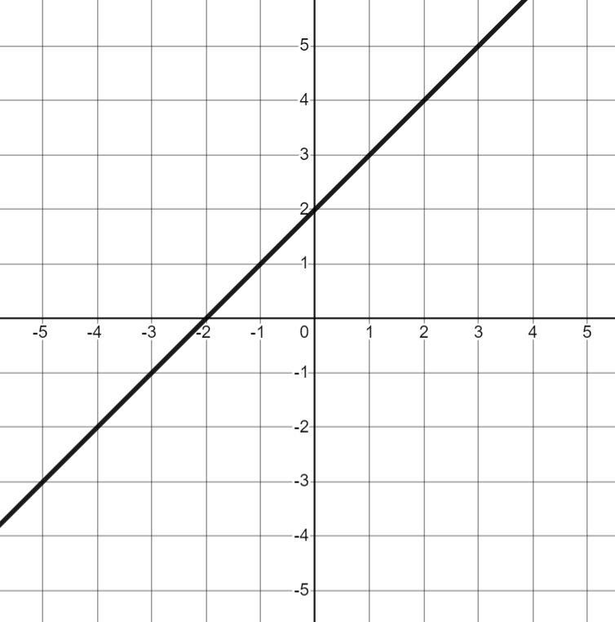
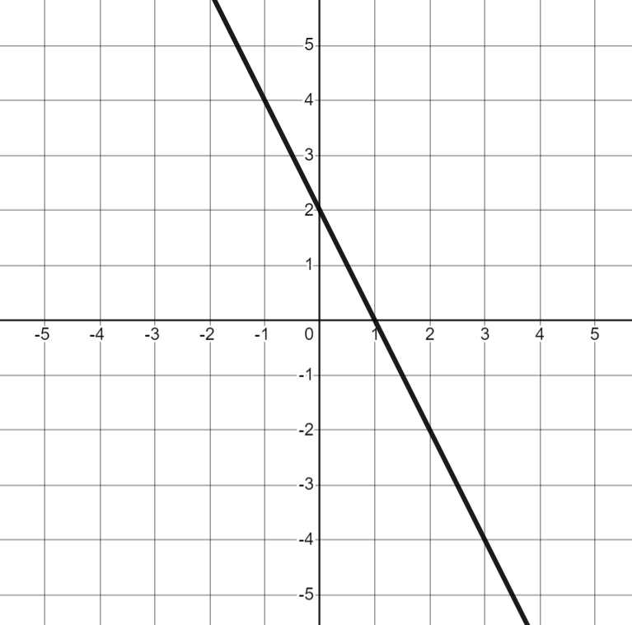

Equations in the form y = mx + c
Match each graph to its equation.
a) | b) | c) | d) | e)
f) | g) | h) | i) | j)
x = 2
y = 2
y = x
y = −x
y = 2 − x
y = x − 2
y = 2x − 2
y = x + 2
y = 2 − x
y = 2 − 2x

Slide 14
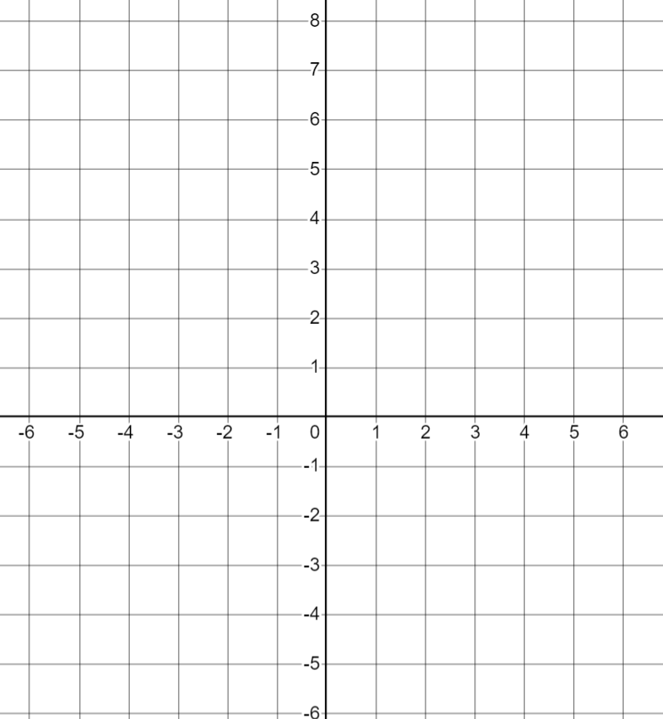
Equations in the form y = mx + c
2) For each question, work out an equation for the line in the form y = mx + c and use the key features to draw the line on the axes.
a)
b)
c)
gradient: 3.
y-intercept: (0, −2)
equation:.
gradient: −1.
y-intercept: (0, 5)
equation:.
gradient: −4
y-intercept: (0, −3)
equation:

Slide 15


Equations in the form y = mx + c
2) For each question, work out an equation for the line in the form y = mx + c and use the key features to draw the line on the axes.
d) | e) | f)
gradient: .
y-intercept: (0, 4)
equation:
gradient: .
y-intercept: (0, −1)
equation:
gradient:
y-intercept: (0, 0)
equation:

Slide 16
Equations in the form y = mx + c
Match each graph to its equation.
a) | b) | c) | d) | e)
y = x
y = 2x − 2
y = 2 − x
x = 2
y = −x
f) | g) | h) | i) | j)
y = 2
y = 2 − x
y = x − 2
y = x + 2
y = 2 − 2x

Slide 17
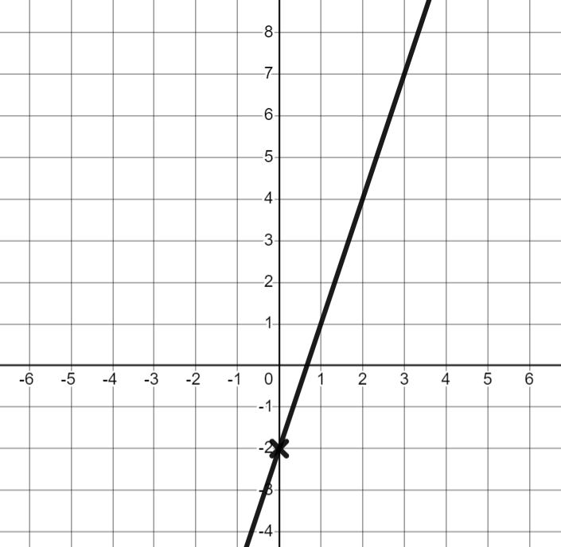
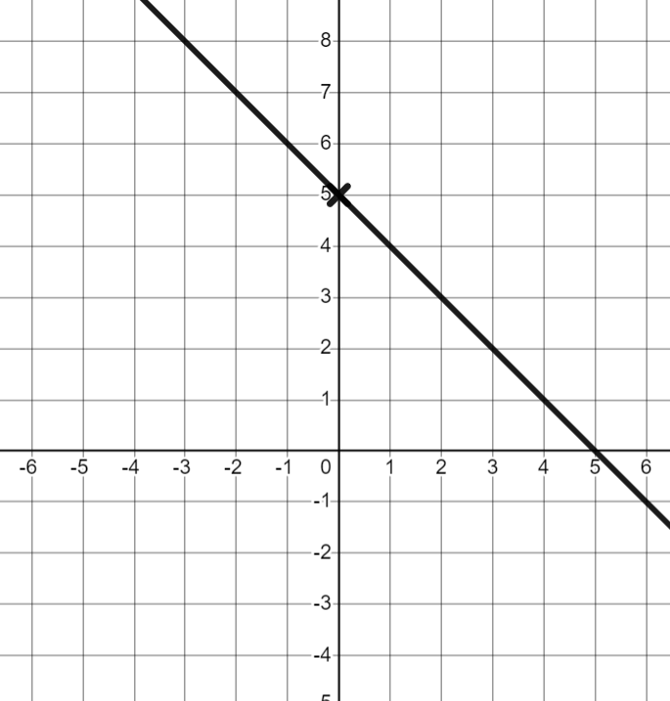
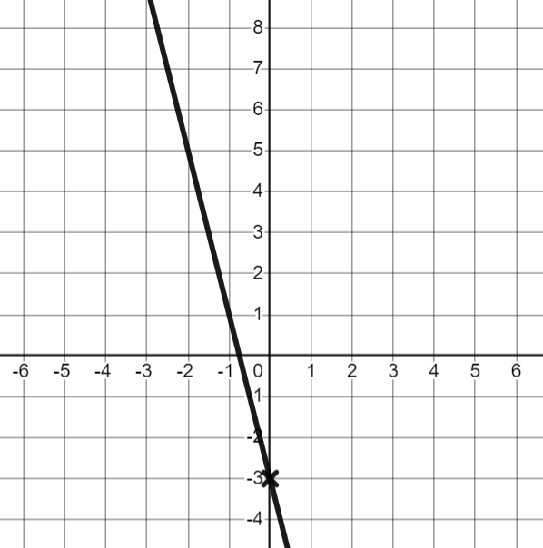
Equations in the form y = mx + c
2) For each question, work out an equation for the line in the form y = mx + c and use the key features to draw the line on the axes.
 | b) | c)
gradient: 3
y-intercept: (0, −2)
equation: y = 3x − 2
gradient: −1
y-intercept: (0, 5)
equation: y = −x + 5
gradient: −4
y-intercept: (0, −3)
equation: y = −4x − 3

Slide 18
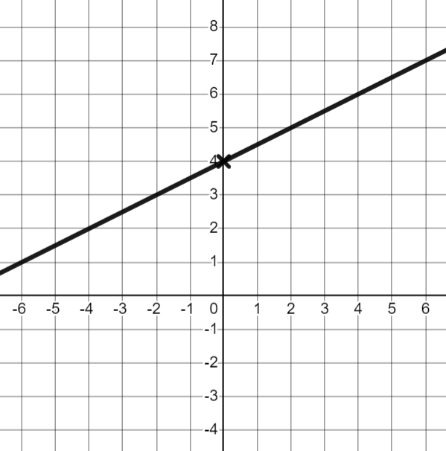
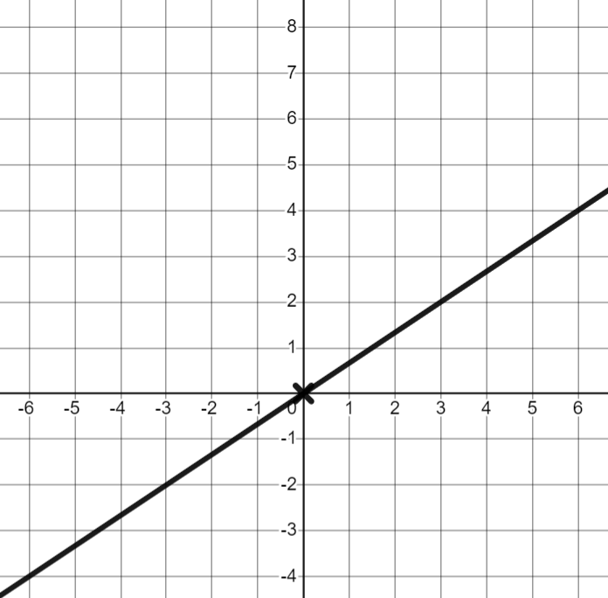
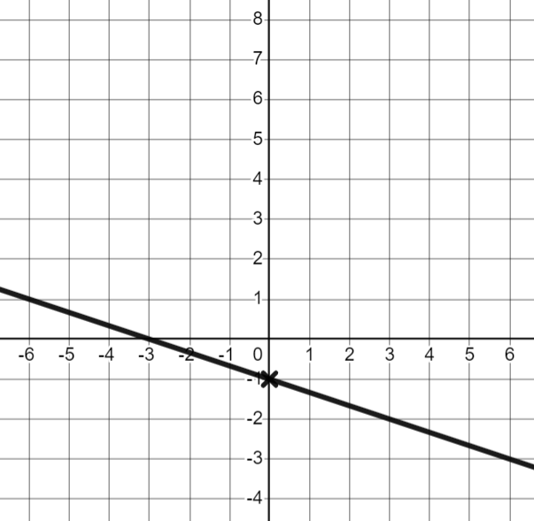
Equations in the form y = mx + c
2) For each question, work out an equation for the line in the form y = mx + c and use the key features to draw the line on the axes.
d) | e) | f)
gradient:
y-intercept: (0, 4)
equation: y = x + 4
gradient:
y-intercept: (0, −1)
equation: y = x − 1
gradient:
y-intercept: (0, 0)
equation: y = x

Slide 19
Finding the equation of the line ay + bx + c = 0
Equations in the form y = mx + c
Equations in the form ay + bx + c = 0

Slide 20
Equations in the form ay + bx + c = 0
Writing equations of lines in other forms can help us identify other features of a graph.
Here is a bar model to show the equation y = 2x − 3
y
3
x
x
What other equations can we write for this bar model?
E.g. y + 3 = 2x
2x − y = 3
2x = 3 + y
What value would we get if we did 2x − y − 3?
Zero
So 2x − y − 3 = 0 is also true for this bar model.
All these relationships are the same, so the graphs of all these equations would be the same as y = 2x − 3

Slide 21
Equations in the form ay + bx + c = 0
We often see equations of straight lines written in the form y = mx + c
However, another form for the equation of a straight line is:
ay + bx + c = 0
Examples
y + x + 2 = 0
2y + 3x = 0
3x − 3y + 1= 0
0 = x + y − 5
Non- examples
x + y = 3
y = 2x + 6
x = 10
x + 3y − 5 = 1
Notice all the equations have been made equal to 0

Slide 22
Equations in the form ay + bx + c = 0
We can use bar models to help write equations in the required form.
y
x
x
x
x
5
If we want to write in the form y = mx + c
y =
4x
+ 5
If we want to write in the form ay + bx + c = 0
4x
+ 5
− y
= 0
or 4x − y + 5 = 0

Slide 23
Equations in the form ay + bx + c = 0
What would the y-intercept be for the graph of the equation y + x − 10 = 0 ?
Substitute x = 0 into the equation.
y + (0) − 10 = 0
y − 10 = 0
What value of y would make this statement true?
y = 10
The y-intercept would be (0, 10)

Slide 24
Equations in the form ay + bx + c = 0
Work out the y-intercept for each graph.
y + x − 1 = 0
The y-intercept is (0, 1)
The y-intercept is (0, −12)
y + x + 12 = 0
y − x + 5 = 0
The y-intercept is (0, −5)
x + y − 3 = 0
The y-intercept is (0, 3)

Slide 25
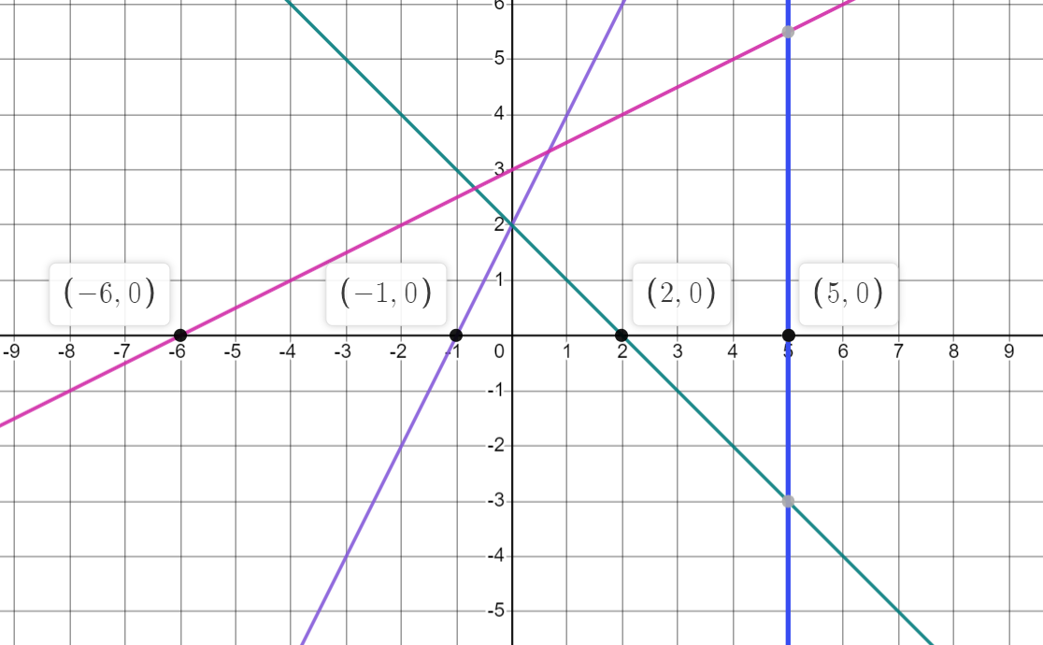
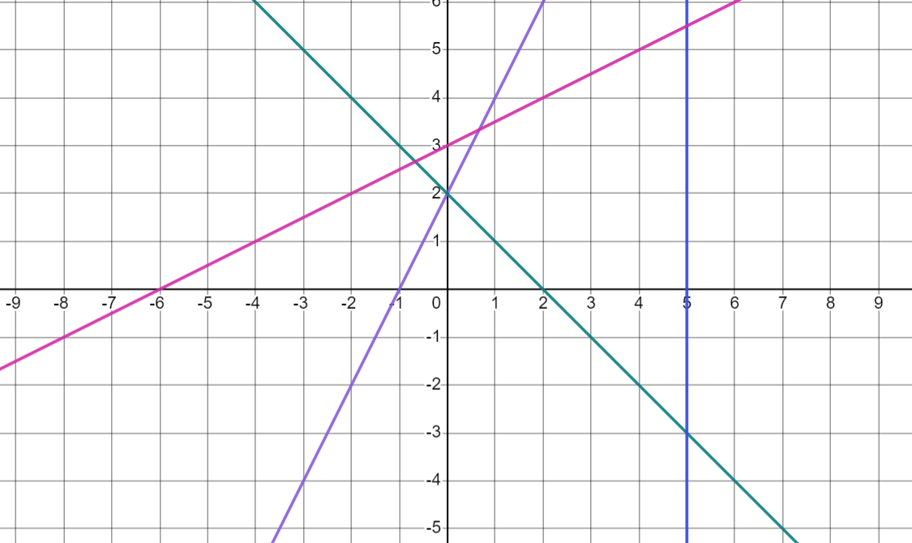
Equations in the form ay + bx + c = 0
We can use a similar idea to find the x-intercepts of the graph.
The x-intercept is where the graph crosses the x-axis.
What are the coordinates of the x-intercepts for these graphs?
What do you notice?
x-intercepts have a y value of 0

Slide 26
Equations in the form ay + bx + c = 0
Where would the graph y + x − 5 = 0 cross the x-axis?
Lines cross the x-axis when y = 0 so substitute y = 0 into the equation.
(0) + x − 5 = 0
x − 5 = 0
What value of x would make this statement true?
x = 5
The x-intercept would be (5, 0)

Slide 27
Equations in the form ay + bx + c = 0
What are the x-intercepts for these graphs?
y + x − 1 = 0
The x-intercept is (1, 0)
y + x + 12 = 0
The x-intercept is (−12, 0)
x + y − 3 = 0
The x-intercept is (3, 0)

Slide 28
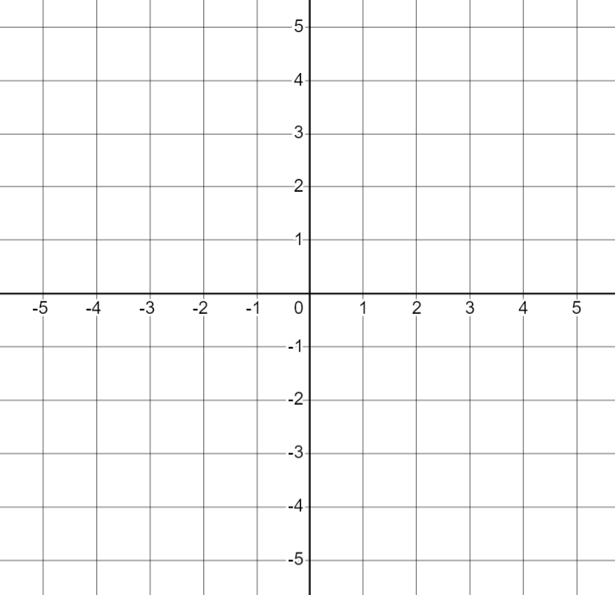
Equations in the form ay + bx + c = 0
Draw the graph with equation y + x + 3 = 0
Draw the graph with equation y + x + 1 = 0
y-intercept
y-intercept
y + (0) + 3 = 0
y + (0) + 1 = 0
y = −3
×
y = −1
×
×
(0, −3)
×
(0, −1)
x-intercept
x-intercept
(0) + x + 3 = 0
(0) + x + 1 = 0
x = −3
x = −1
(−3, 0)
(−1, 0)

Slide 29
Equations in the form ay + bx + c = 0
Let's have a look at some graphs in the form ay + bx + c = 0 where a and b are not 1
Draw the graph with equation 2y + 3x − 6 = 0
y-intercept
Lines cross the y-axis when x = 0 so substitute x = 0 into the equation
2y + 3(0) − 6 = 0
2y + 0 − 6 = 0
2y − 6 = 0
2y = 6 because (6) − 6 = 0

Slide 30
Equations in the form ay + bx + c = 0
This time 2y = 6
What value for y would make this true?
y
y
y
y
=
6
1
1
1
1
1
1
y
1
1
1
So y = 3
The y-intercept for 2y + 3x − 6 = 0 would be (0, 3)

Slide 31
Equations in the form ay + bx + c = 0
Draw the graph with equation 2y + 3x − 6 = 0
The y-intercept for 2y + 3x − 6 = 0 would be (0, 3)
Lines cross the x-axis when y = 0 so substitute y = 0 into the equation.
2(0) + 3x − 6 = 0
x
x
x
x
x
x
=
0 + 3x − 6 = 0
6
1
1
1
1
1
1
3x − 6 = 0
So x = 2
The x-intercept for 2y + 3x − 6 = 0 is (2,0)
3x = 6 because (6) − 6 = 0

Slide 32
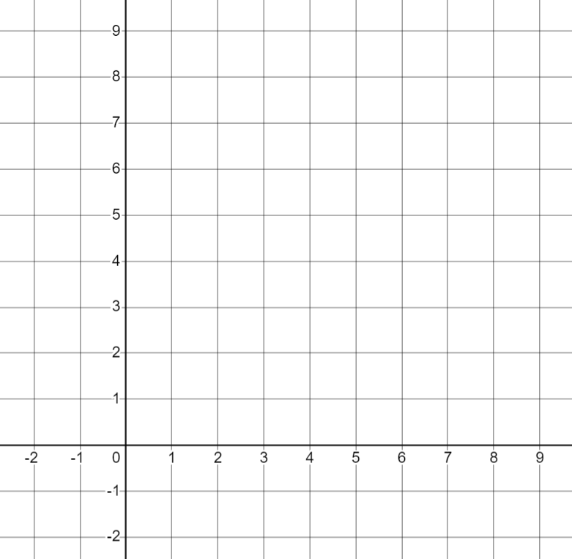
Equations in the form ay + bx + c = 0
Draw the graph with equation 2y + 3x − 6 = 0
The y-intercept for 2y + 3x − 6 = 0 would be (0, 3)
The x-intercept for 2y + 3x − 6 = 0 is (2, 0)
×
×

Slide 33
Equations in the form ay + bx + c = 0
Select the correct option to complete the sentence.
The x-intercept is .
where the x coordinate is zero
where the y coordinate is zero
where the gradient is zero

Slide 34
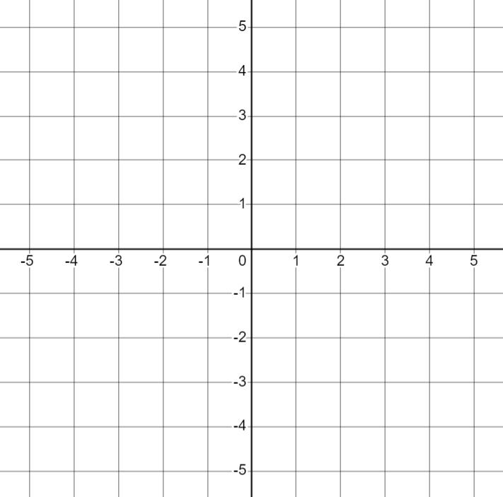
Equations in the form ay + bx + c = 0
For each equation, work out the y-intercept, the x-intercept and draw the graph.
a) y + x − 4 = 0 | b) y + x − 2 = 0 | c) y + x + 2 = 0
y-intercept (0, )
y-intercept ( , )
y-intercept ( , )
x-intercept ( ,0)
x-intercept ( , )
x-intercept ( , )

Slide 35
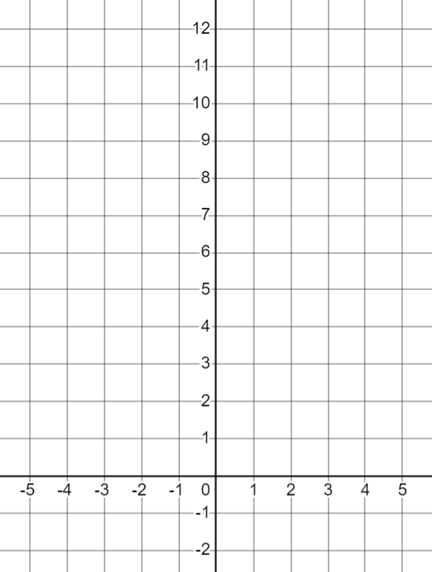
Equations in the form ay + bx + c = 0
2) From the bar model, write the relationship as as an equation in the form y = mx + c and ax + by + c = 0
3) Fill in the missing working, then draw the graph of 2y + 5x − 20 = 0
y-intercept
a)
y
2
2y + 5(0) − 20 = 0
x
x
x
2y − 20 = 0
2y = .
y = mx + c :
ax + by + c = 0 :
y = 10 ( , ).
x-intercept
b)
10
+ 5x − 20 = 0
y
x
x
5x − = 0
y = mx + c :
ax + by + c = 0 :
5x = .
x = 4 ( , ).

Slide 36
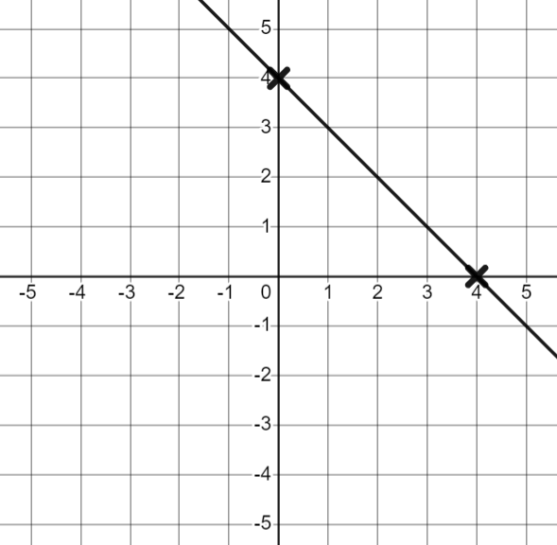
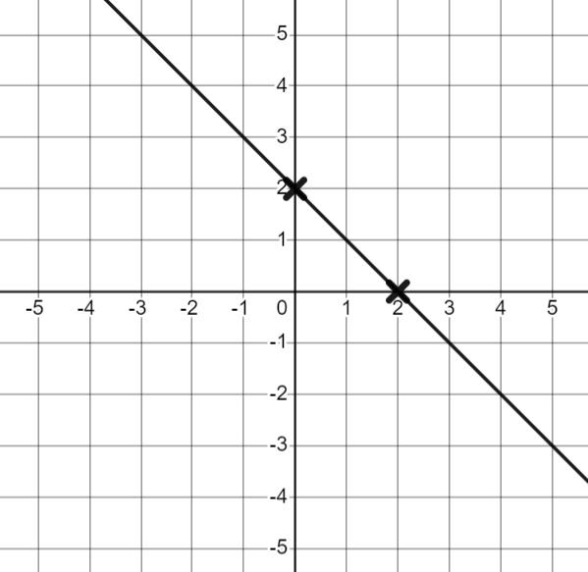
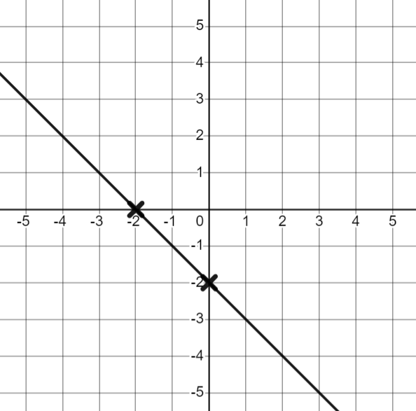
Equations in the form ay + bx + c = 0
For each equation, work out the y-intercept, the x-intercept and draw the graph.
a) y + x − 4 = 0 | b) y + x − 2 = 0 | c) y + x + 2 = 0
y-intercept (0, 4)
y-intercept (0, 2)
y-intercept (0, −2)
x-intercept (4, 0)
x-intercept (2, 0)
x-intercept (−2, 0)

Slide 37
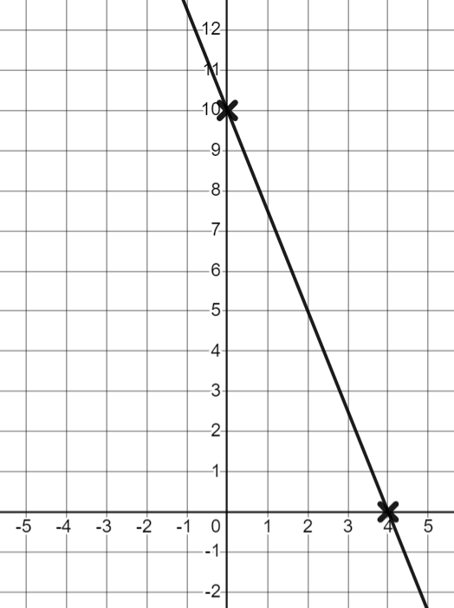
Equations in the form ay + bx + c = 0
2) From the bar model, write the relationship as as an equation in the form y = mx + c and ax + by + c = 0
3) Fill in the missing working, then draw the graph of 2y + 5x − 20 = 0
y-intercept
a)
y
2
2y + 5(0) − 20 = 0
x
x
x
2y − 20 = 0
2y = 20
y = mx + c : y = 3x − 2
ax + by + c = 0 : 3x − y − 2 = 0
y = 10 (0, 10)
x-intercept
b)
10
2(0) + 5x − 20 = 0
y
x
x
5x − 20 = 0
y = mx + c : y = 10 − 2x
ax + by + c = 0 : 2x + y − 10 = 0
5x = 20
x = 4 (4, 0)

Slide 38
Finding the equation of the line ay + bx + c = 0
Linear equations can be written in multiple forms.
When in the form y = mx + c we can draw the graph of the equation from the gradient and y-intercept.
When in the form ay + bx + c = 0 we can draw the graph of the equation from the y-intercept and x-intercept.
The y-intercept occurs when x = 0 and the x-intercept occurs when y = 0

Slide 39

© Oak National Academy 2023.
Produced in partnership with Mathematics in Education and Industry.
Licensed on the Open Government Licence v3.0, except where otherwise stated. See Oak terms and conditions.

